Slide 1
Floral Morphology I & II
Judd et al. pp. 73-85.
Angiosperms only!

Slide 2
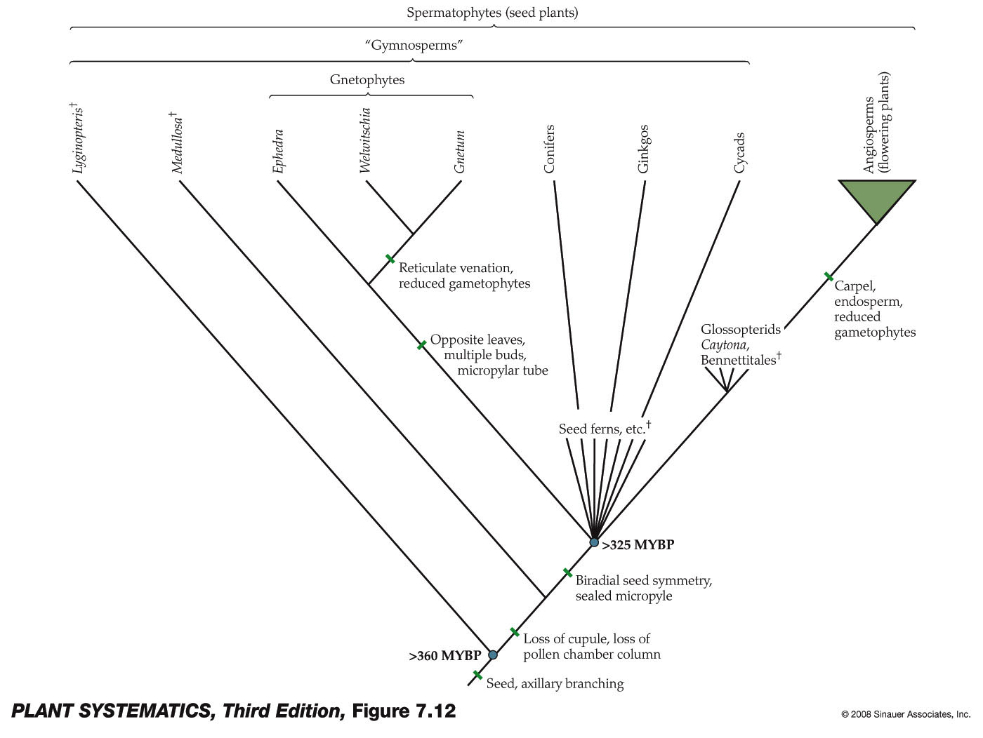
Which Plants Have Flowers?
We are only talking about Angiosperms today, the flowering plants.
Ferns, Bryophytes, Lycophytes and Green Algae are all down here

Slide 3
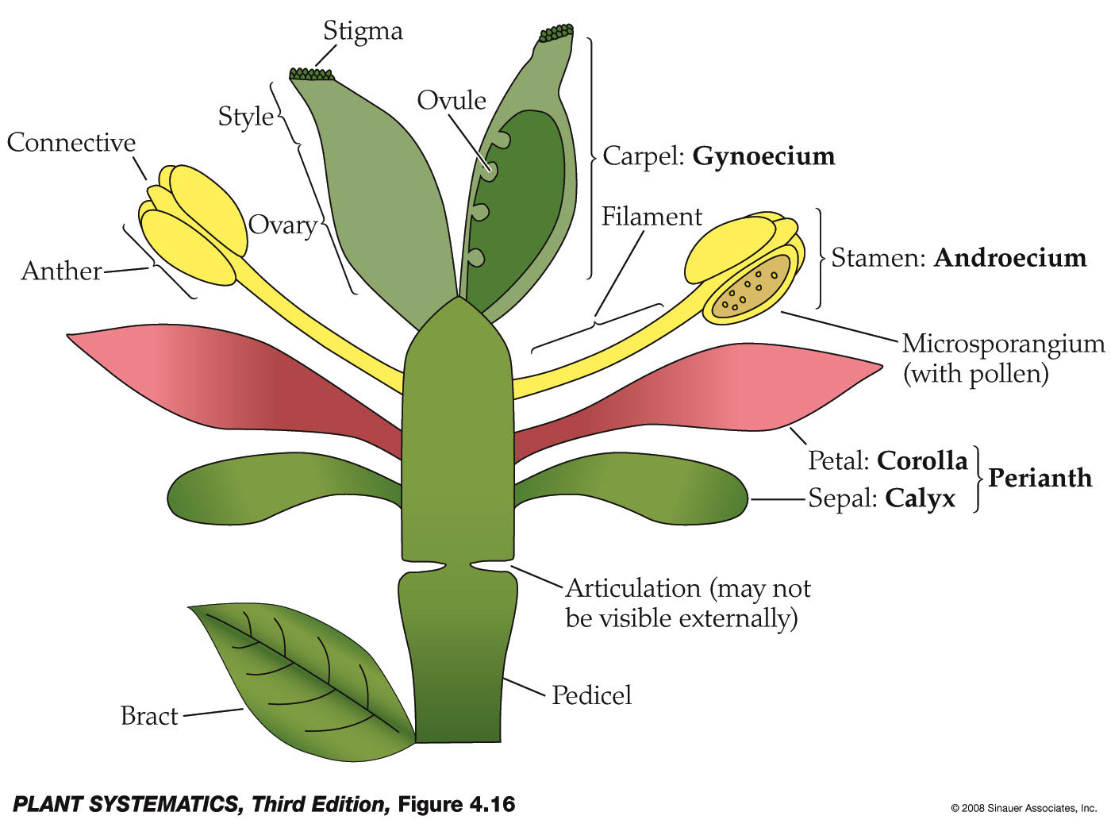
Parts of a Generalized Flower

Slide 4
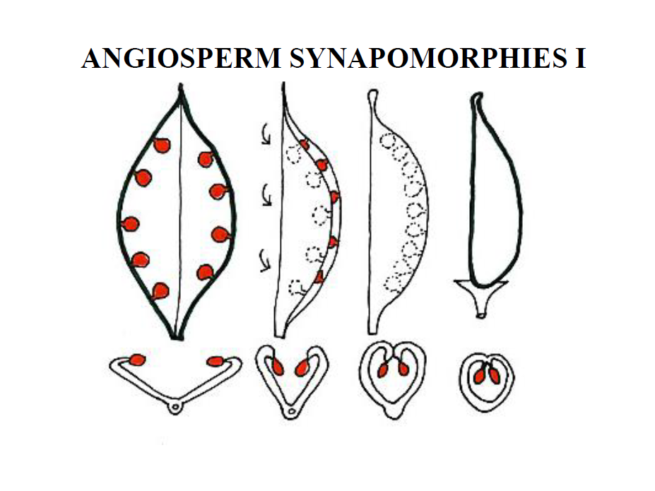
Origin of the Carpel– one hypothesis

Slide 5
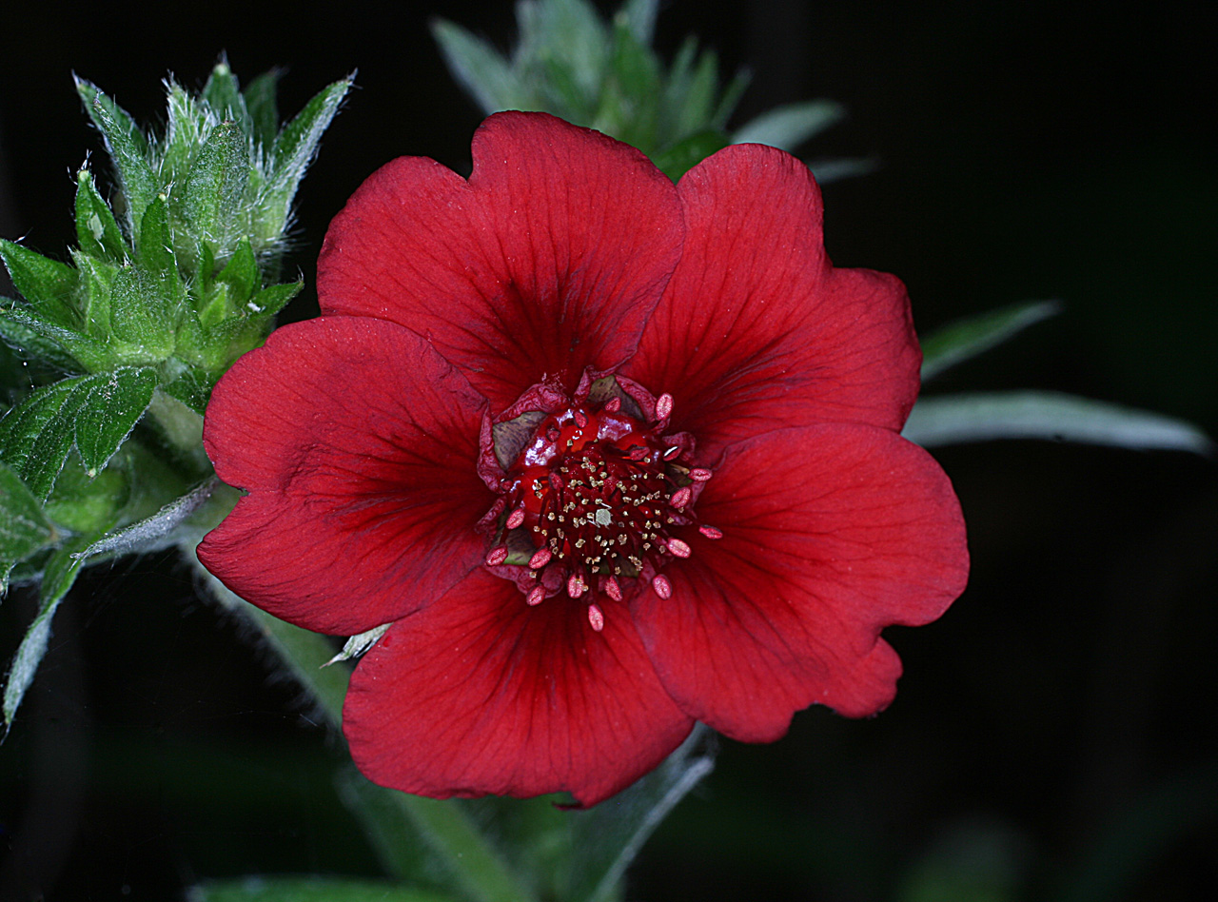
Potentilla thurberi
Bisexual= perfect flowers.

Slide 6
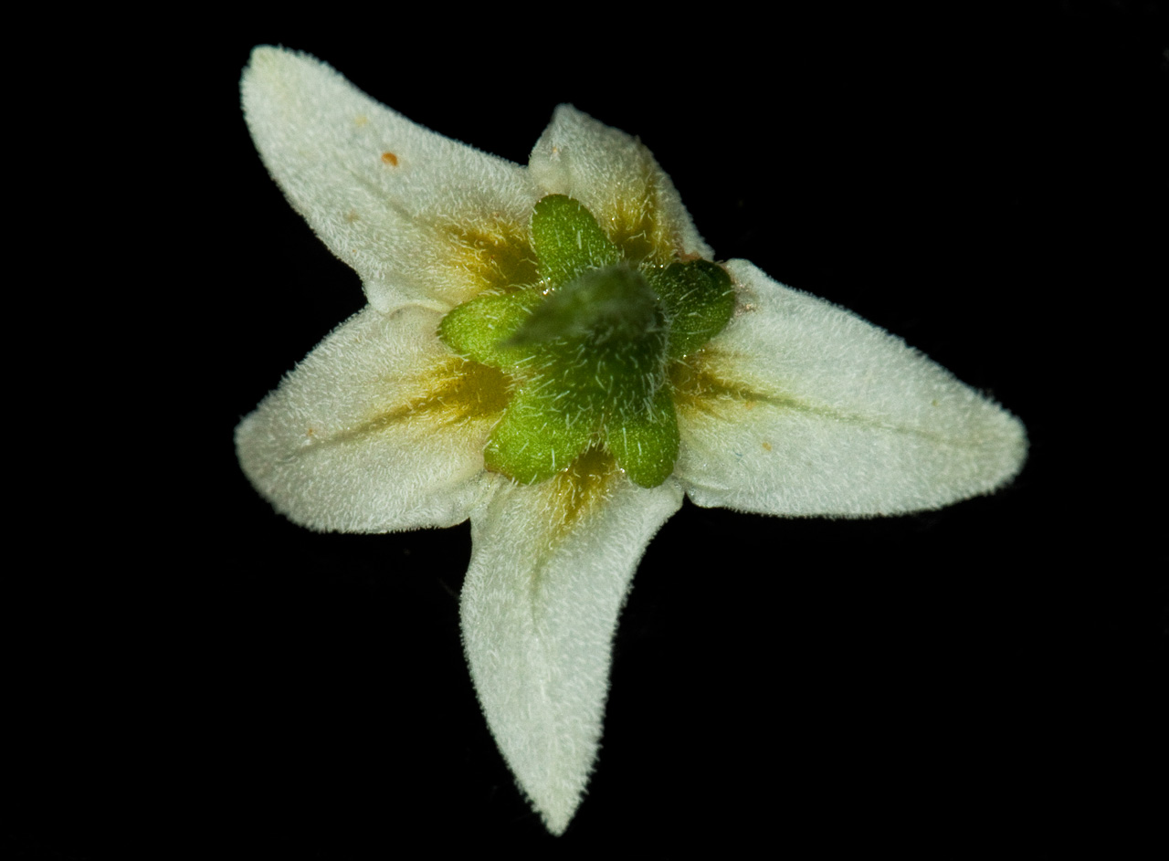
Solanum nigrum
Calyx
Corolla
The calyx and corolla are 5-merous.

Slide 7
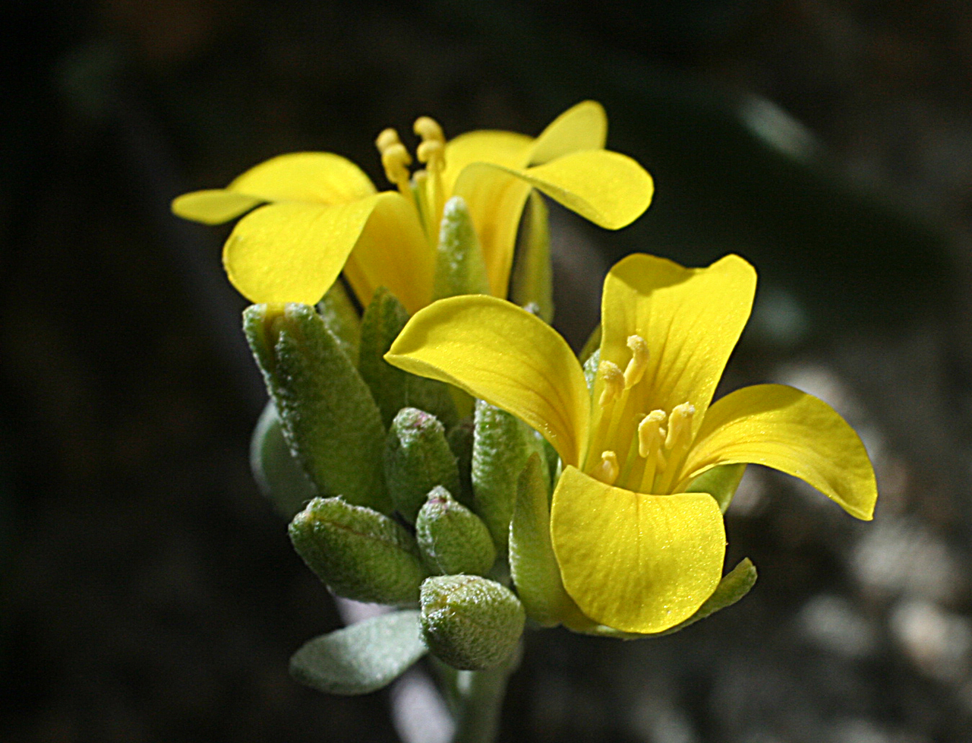
Physaria fendleri-- tetradynamous
Bisexual flowers

Slide 8
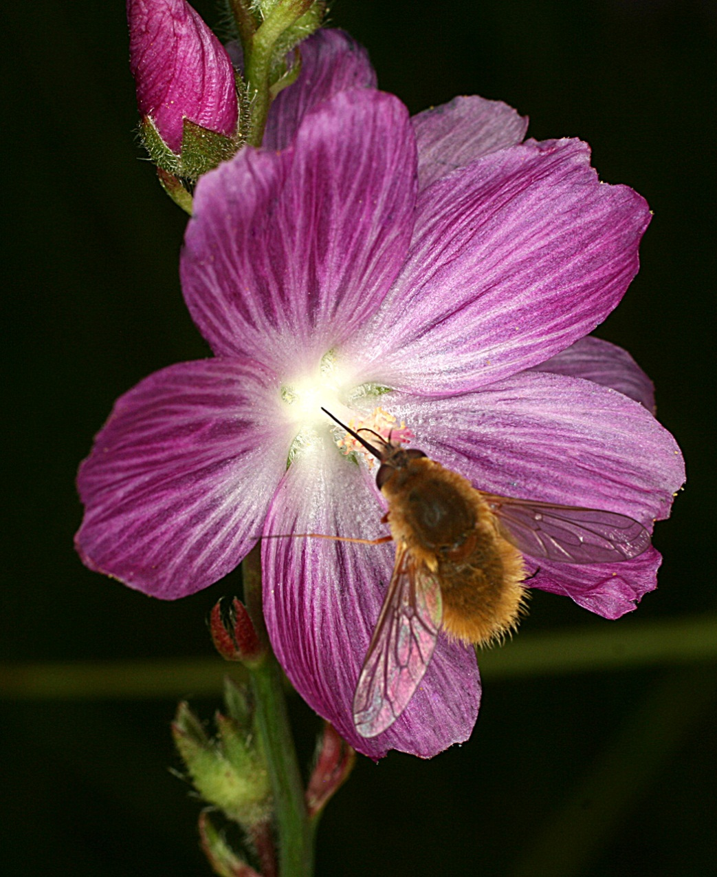
Sidalcea neomexicana– monadelphous stamens
Bisexual flowers

Slide 9
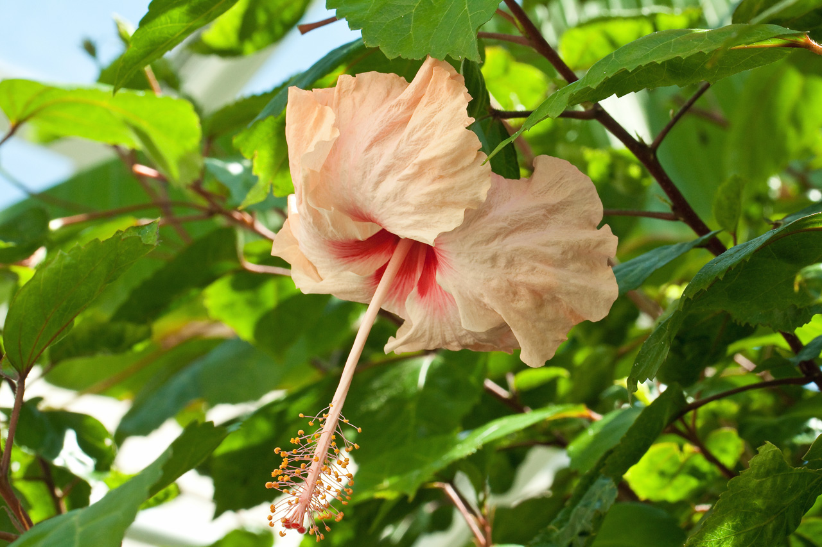
Hibiscus (Malvaceae)

Slide 10
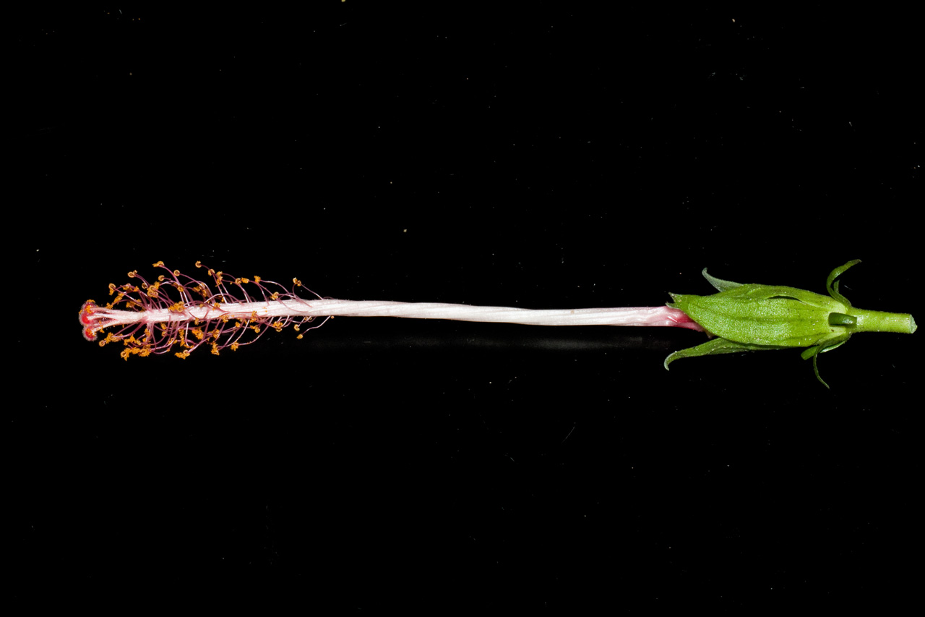
Hibiscus: monadelphous stamens
Stamens fused by their filaments into a single group usually forming a tube

Slide 11
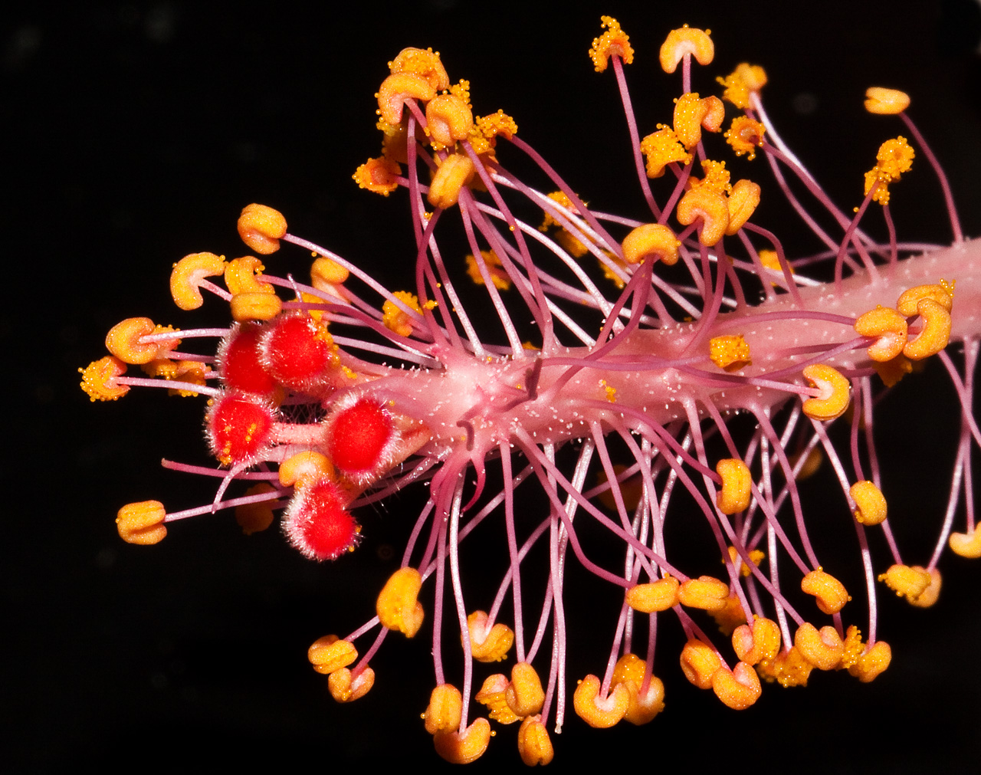
Hibiscus: Carpels (style branches)

Slide 12
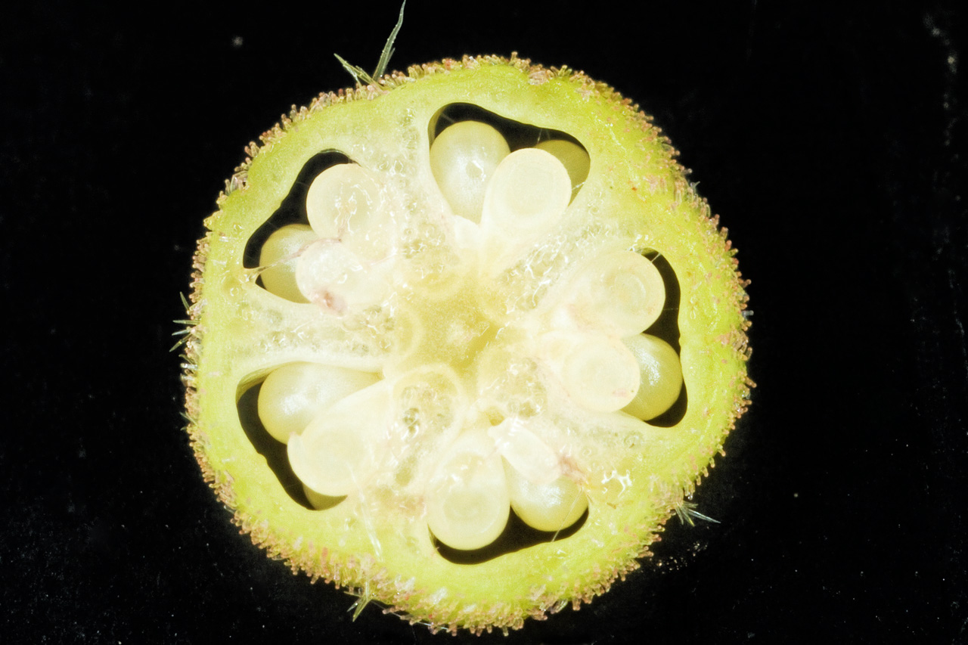
Hibiscus: Carpels (locules or rows of ovules/2)

Slide 13
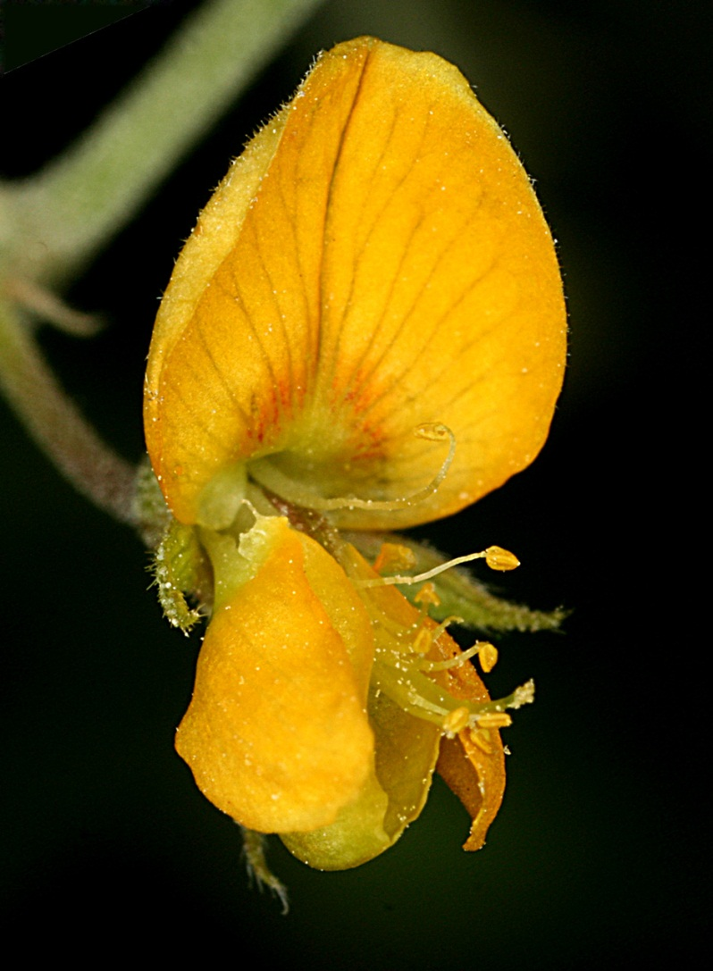
Rhynchosia senna– diadelphous stamens
Bisexual flowers
One carpel

Slide 14
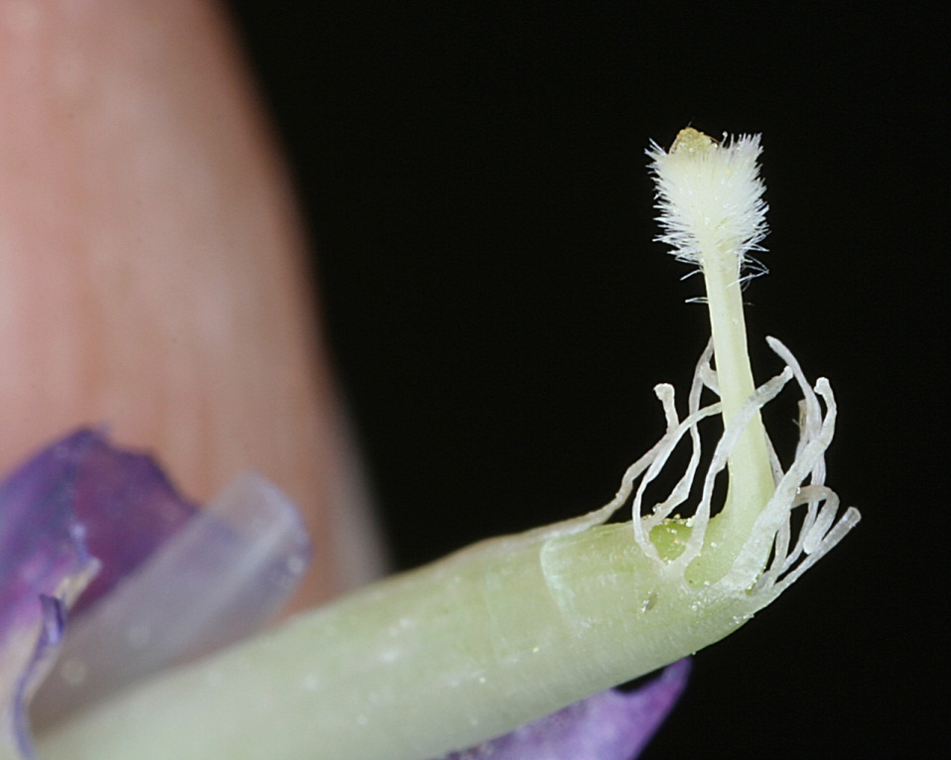
Vicia americana: diadelphous stamens
How many carpels might you think?

Slide 15
Floral Morphology
Complete/incomplete-- if sepals, petals, androecium & gynoecium present= complete.
Androecium & gynoecium present at least= perfect (bisexual), otherwise imperfect (unisexual) (and then staminate or carpellate.)
Monoecious= both staminate and carpellate flowers on one individual
Dioecious= requires 2 plants for reproduction
When unisexual flowers present

Slide 16
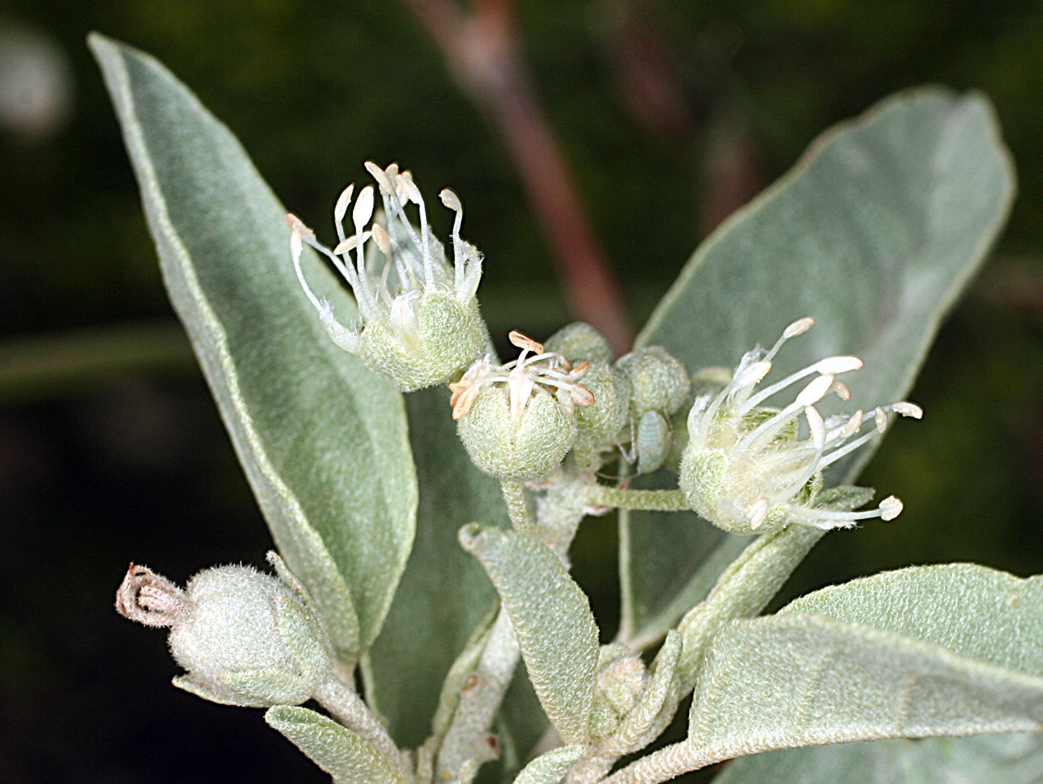
Croton pottsii: unisexual flowers, but both sexes on same plant= Monoecious

Slide 17
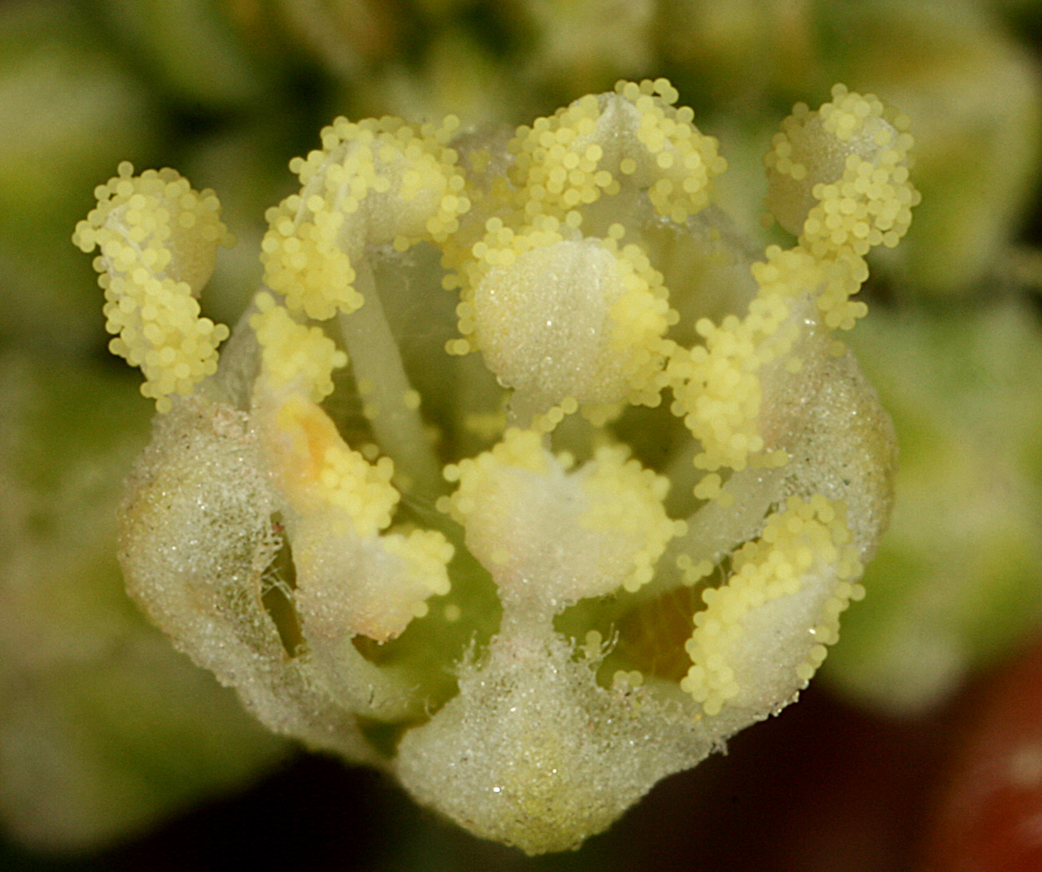
Croton texensis: unisexual flowers, only one sex per plant= Dioecious

Slide 18
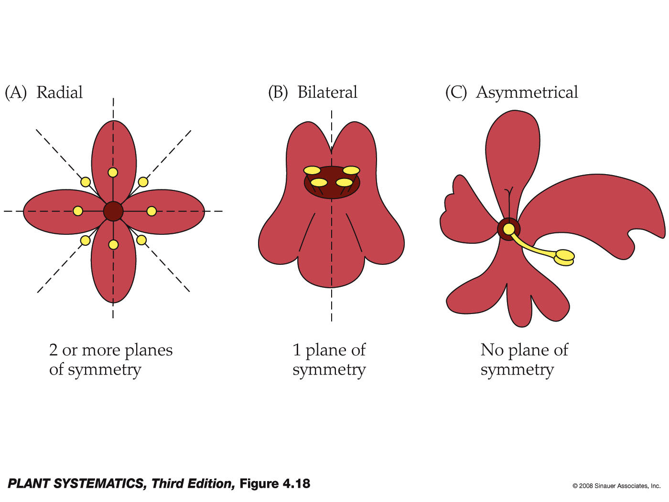
Patterns of Floral Symmetry
= Actinomorphic
= Zygomorphic

Slide 19
Zygomorphic-- Salverform
Salverform– slender tube (connate petals) with abruptly flaring distal limb.
Funnelform– slender tube (connate petals) with funnel-shape.

Slide 20
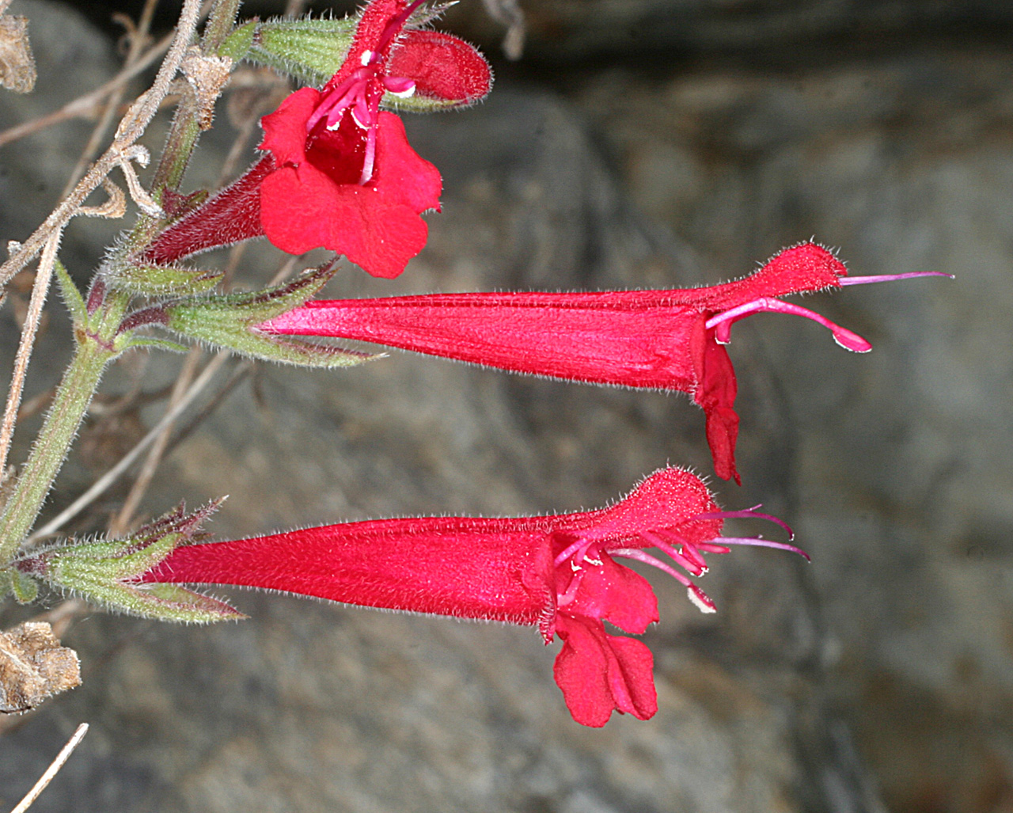
Salverform

Slide 21
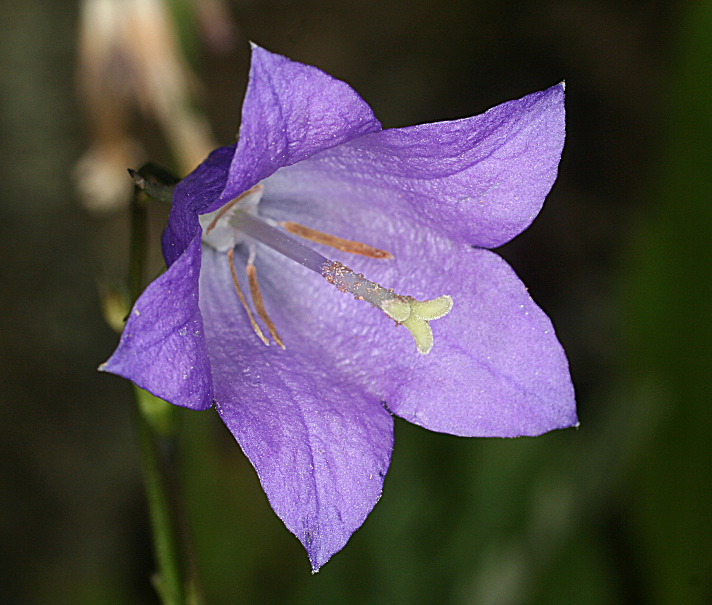
Funnelform

Slide 22
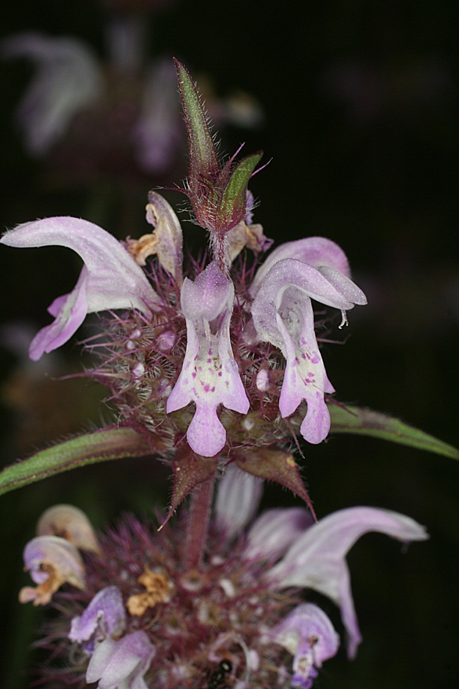
Monarda pectinata

Slide 23
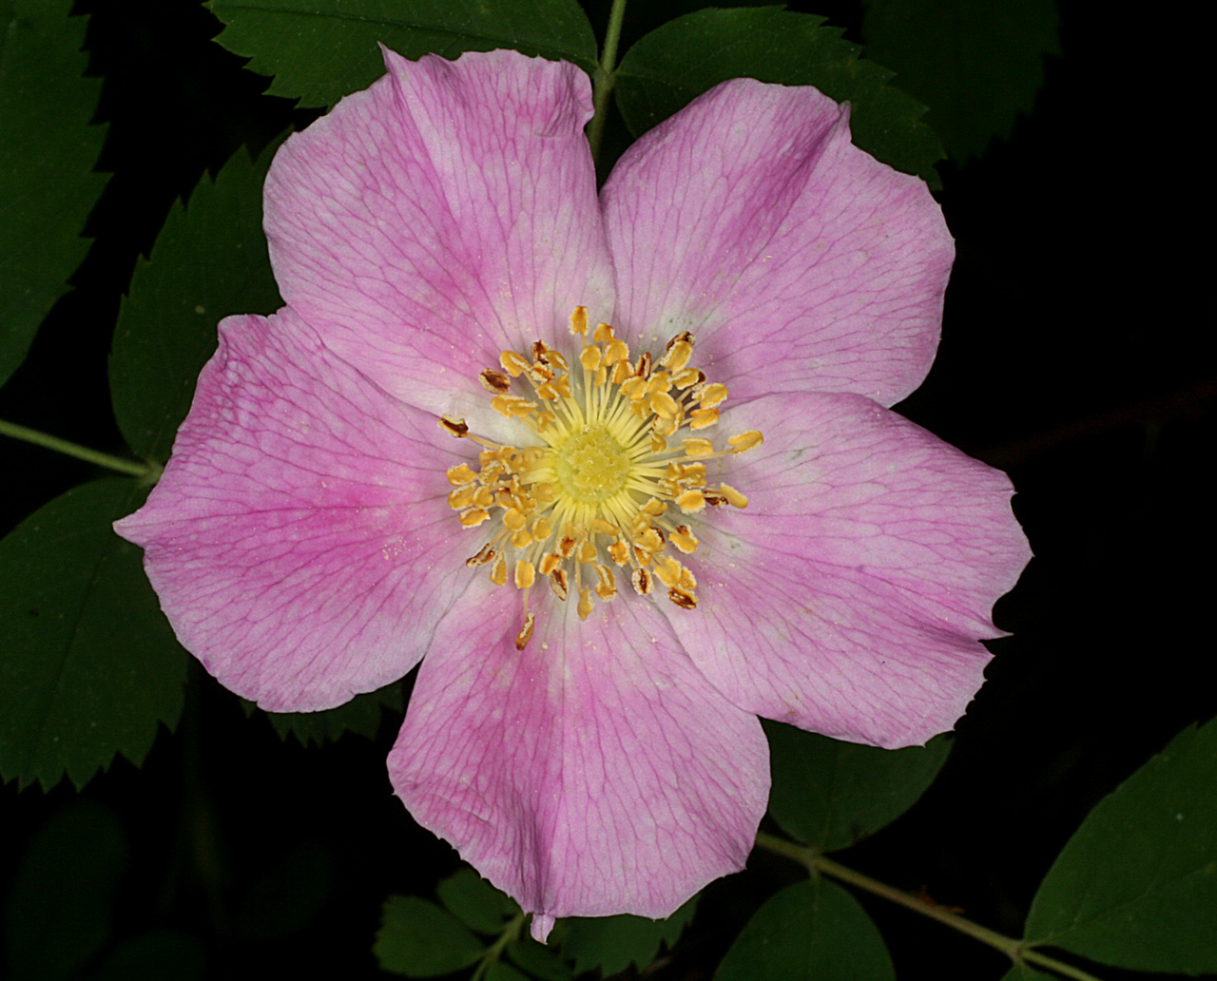
Rosa woodsii

Slide 24
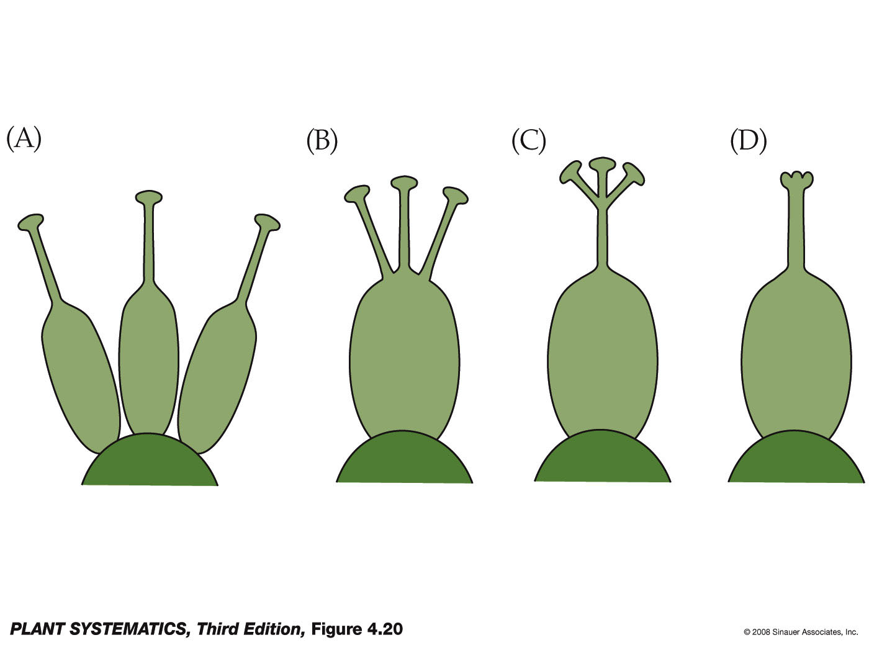
Connate/distinct and Adnate/free
Terms used for like structures
Terms used for different types of structures
apocarpous
syncarpous
Distinct carpels
Various degrees of connation

Slide 25
Ways to Determine Carpel Number
Count locule number by transversely dividing the ovary.
Count number of styles, stigmas or stigmatic lobes.
Count number of lobes of ovary.
Divide number of rows of ovules by two.

Slide 26
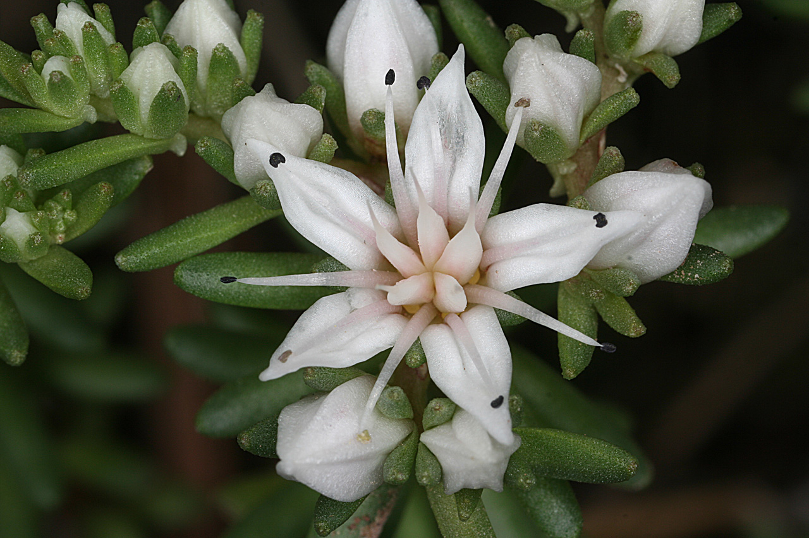
Sedum cockerelli
Merosity of corolla= ?
5 distinct carpels= apocarpous

Slide 27
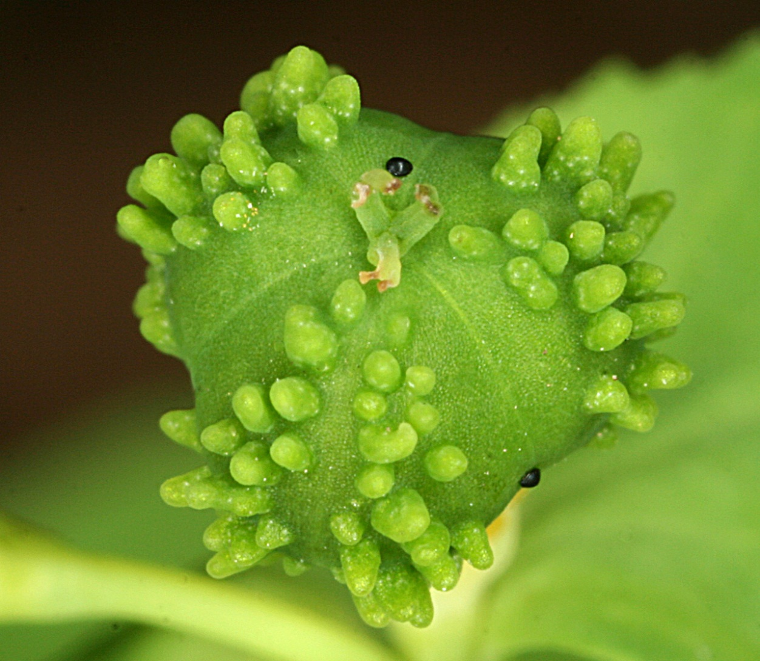
Euphorbia alta
Three connate carpels

Slide 28
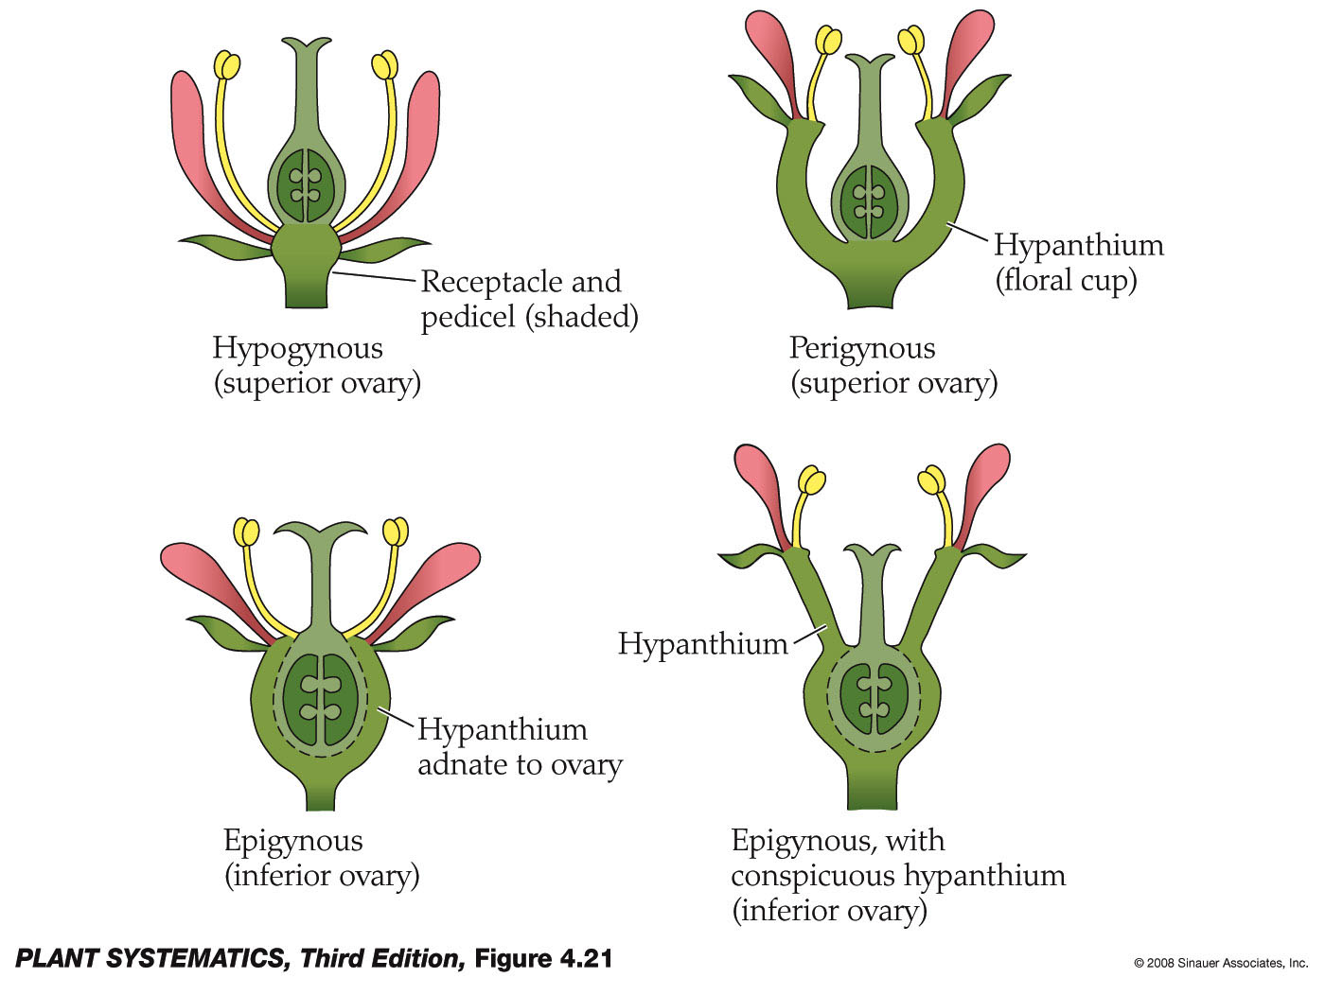
Insertion Types
Very common situation
A Hypanthium is a floral cup on which the petals, sepals and stamens are attached.

Slide 29

Insertion Types
Important things to note:
All flowers with an epigynous insertion have an inferior ovary. (vice versa also true– all flowers with an inferior ovary have an epigynous insertion.
All flowers with a hypogynous insertion have a superior ovary.
All flowers with a perigynous insertion have a superior ovary and a hypanthium.
A hypanthium can be present with either a superior or inferior ovary.
Note also that if you have an inferior ovary, then you also have a hypanthium
This forms a “pome” in the rosaceae with an inferior ovary and fleshy fruit.

Slide 30
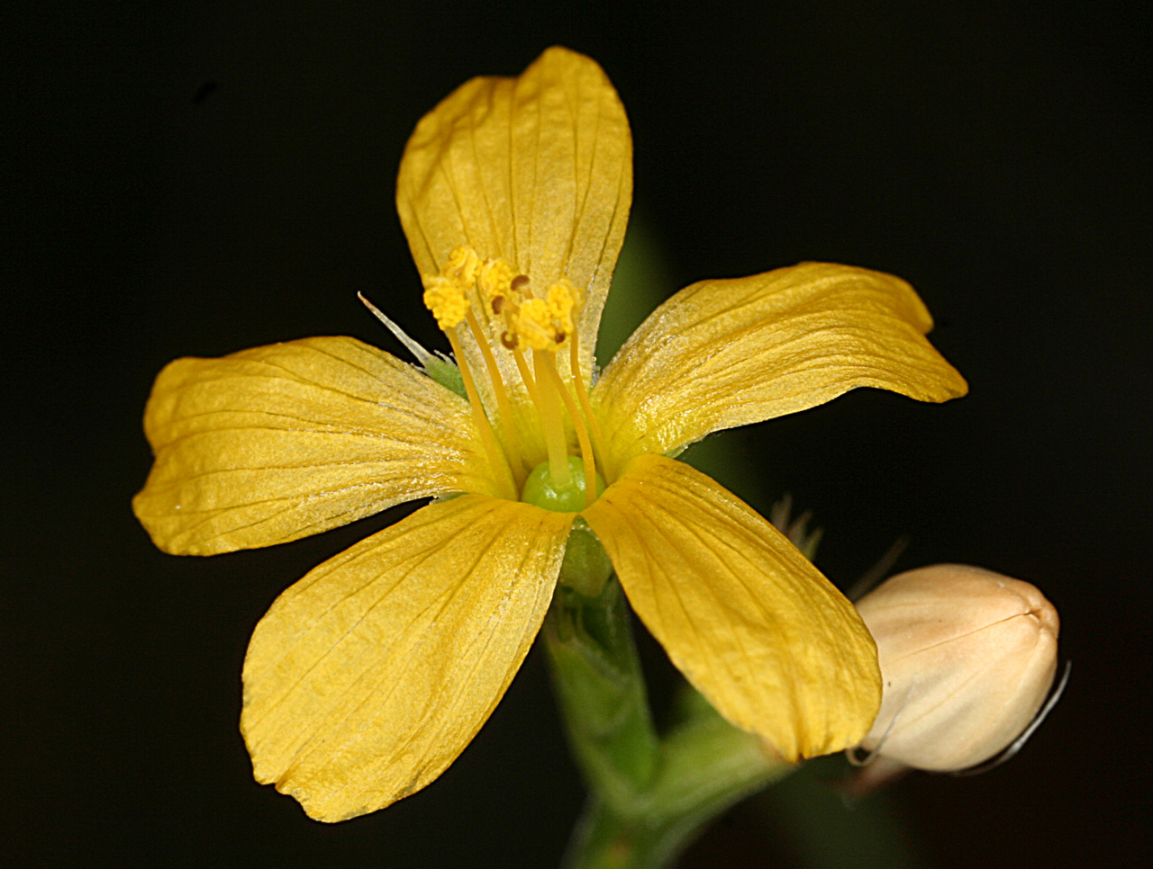
Linum neomexicanum– superior ovary

Slide 31
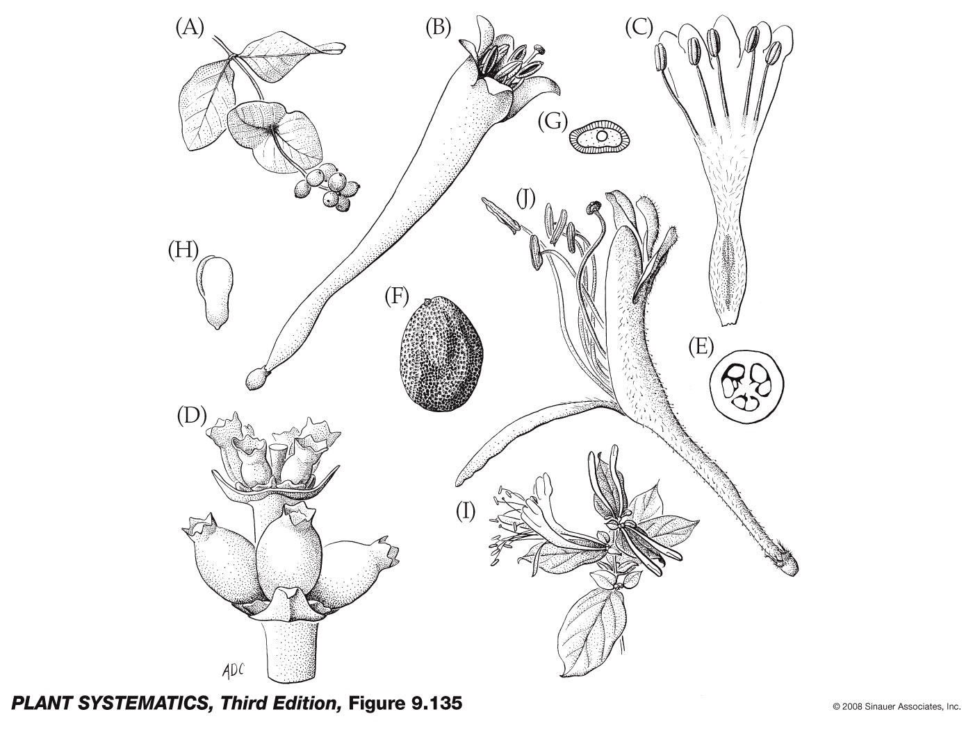
Lonicera japonica (I-J)
Inferior ovary

Slide 32
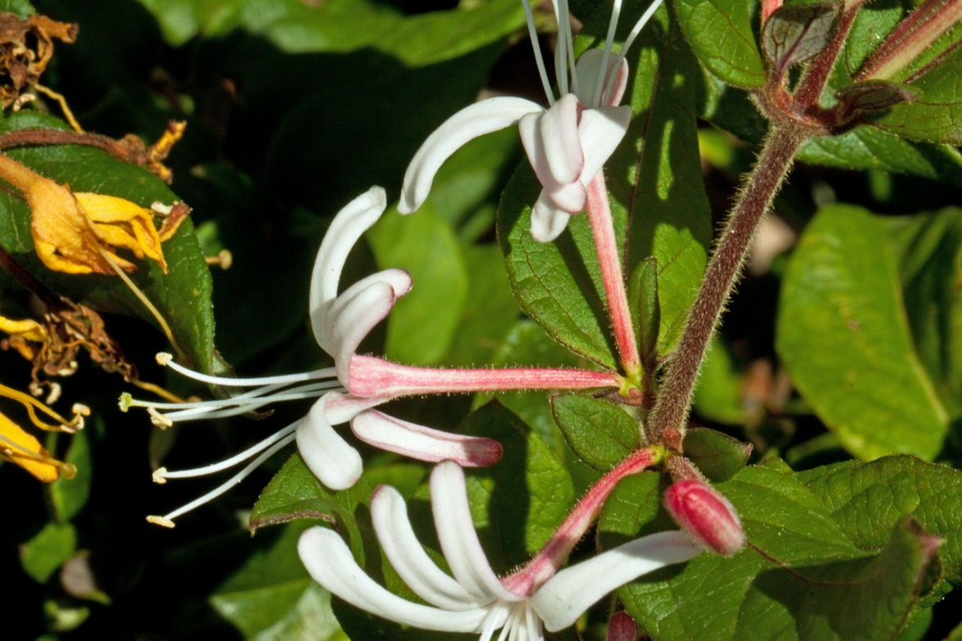
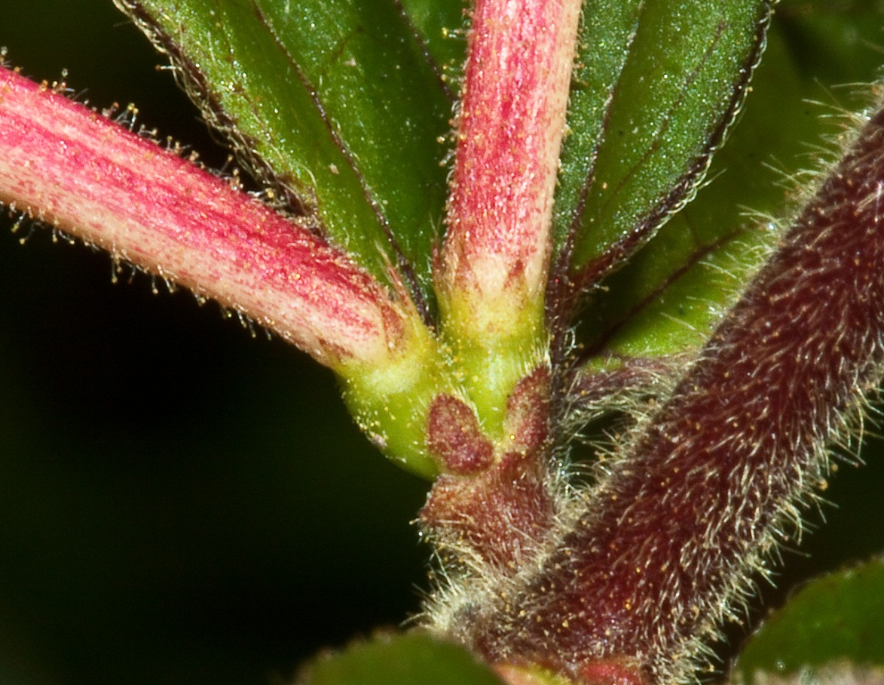
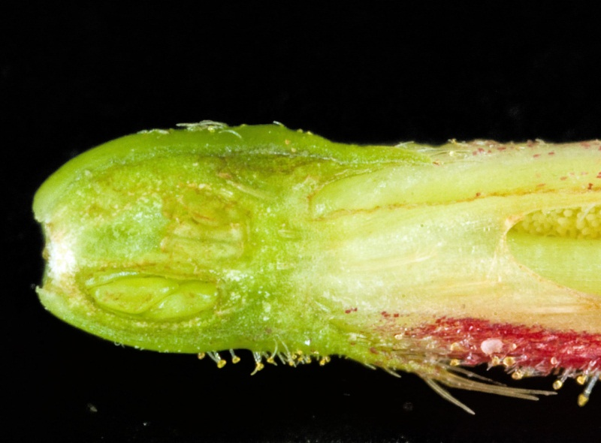
Lonicera japonica

Slide 33
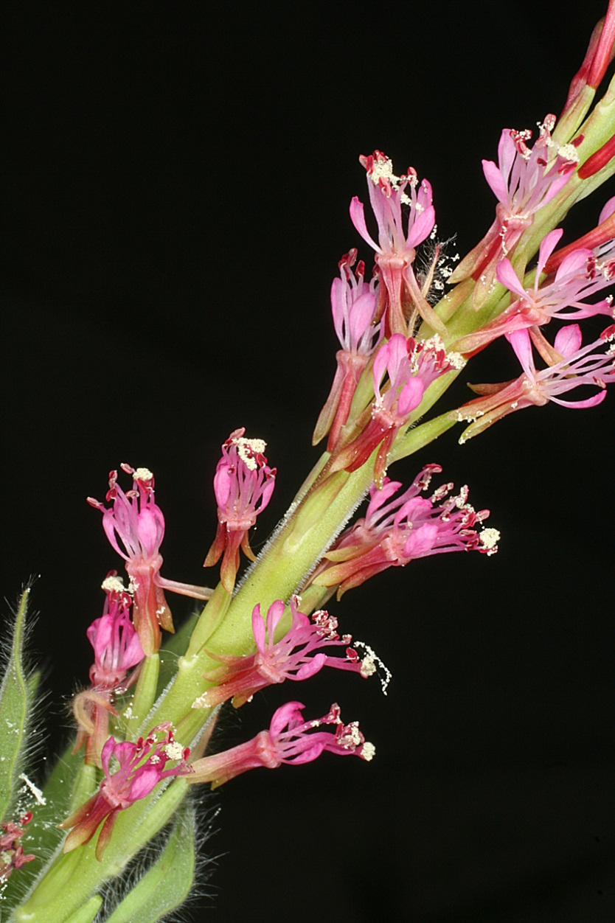
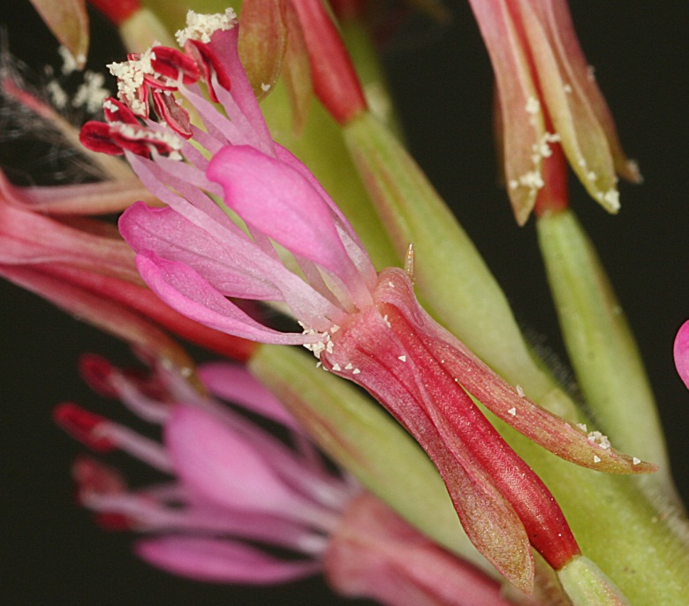
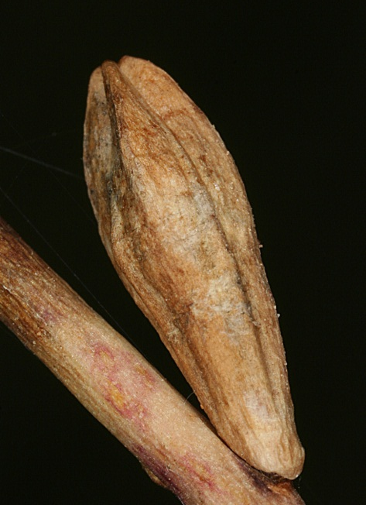
Oenothera curtiflora– inferior ovary

Slide 34
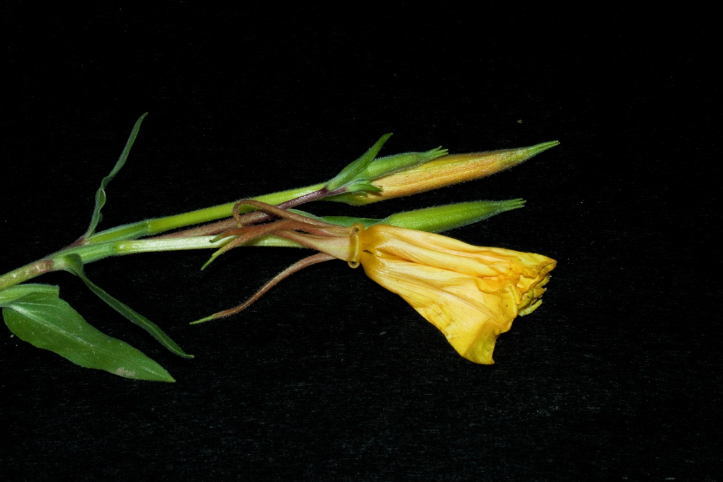
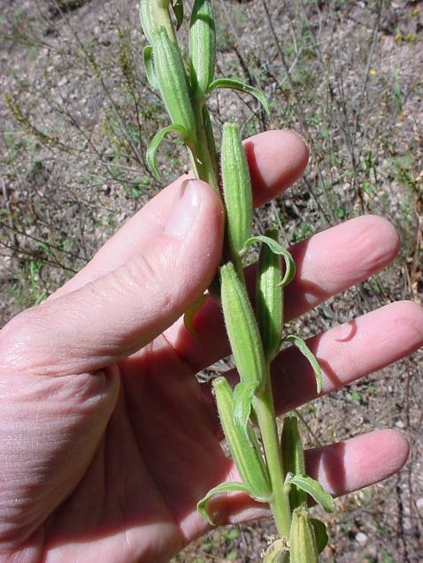
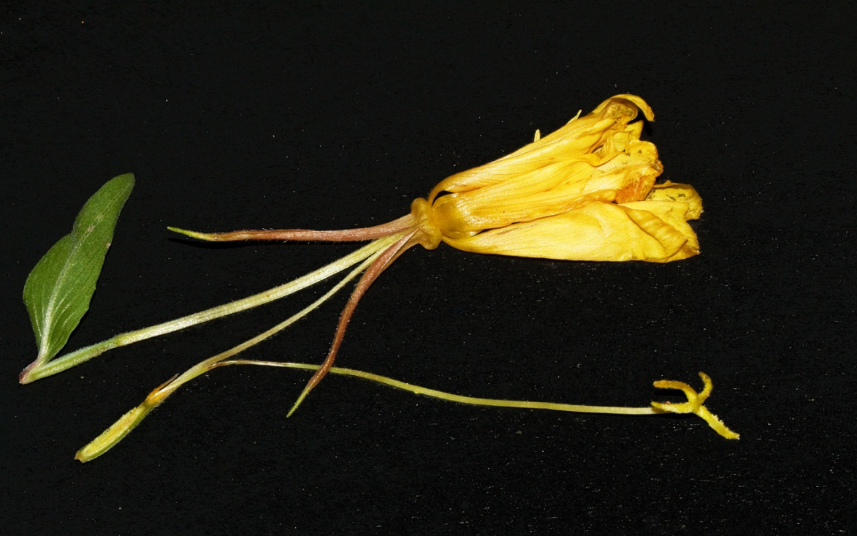
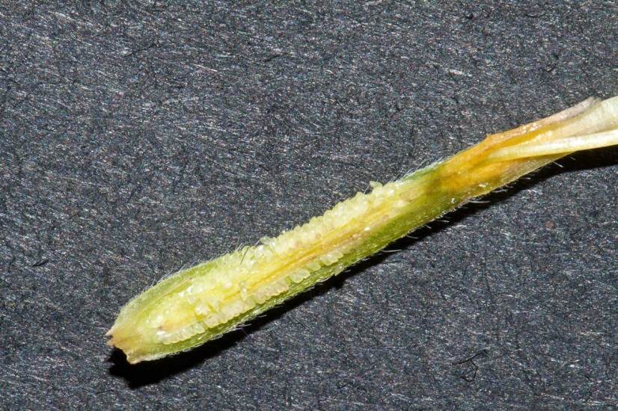
Oenothera elata– inferior ovary
Capsules
Ovary
Closeup of bisected ovary showing ovules
Style
Stigma lobes

Slide 35
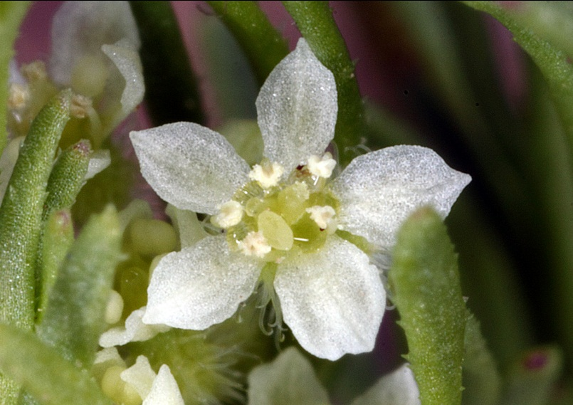
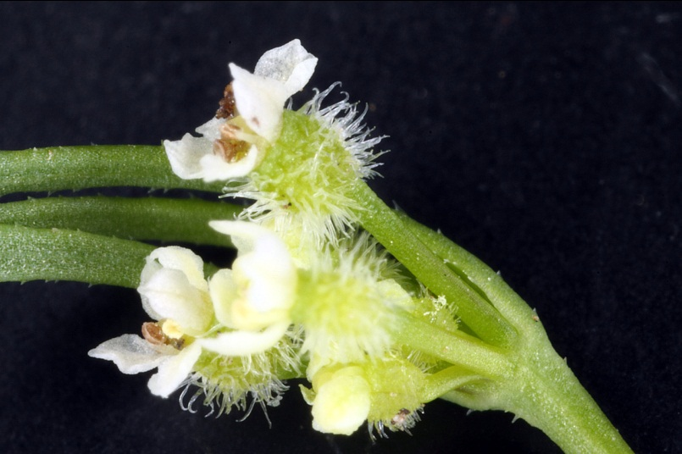
Daucus pusillus– inferior ovary
(epigynous insertion)

Slide 36
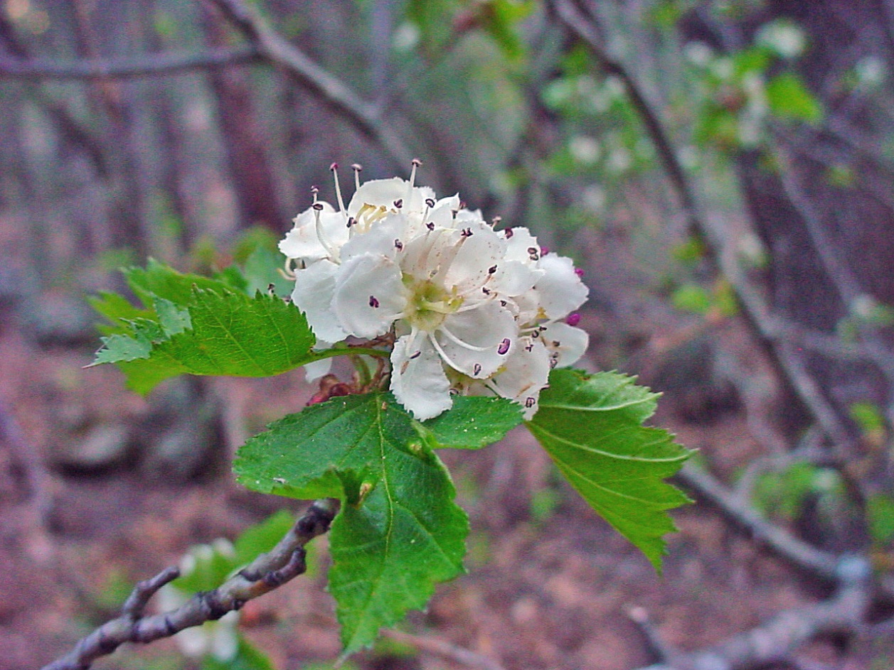
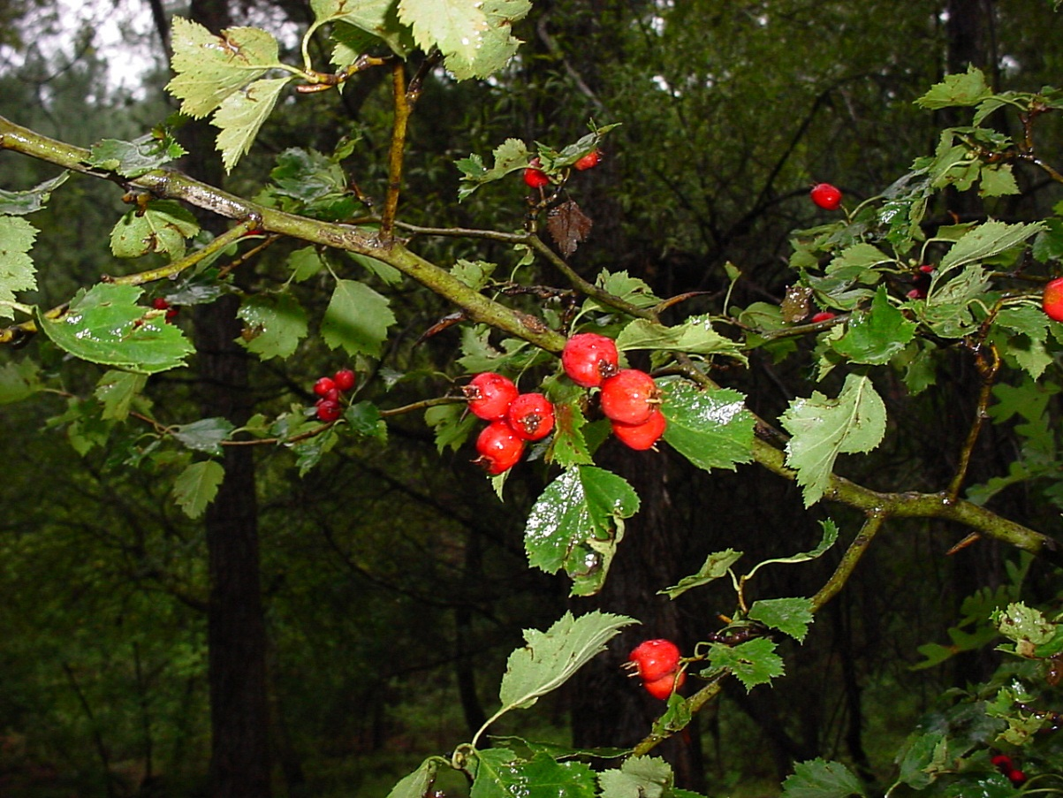
Crataegus wootoniana– hypanthium with inferior ovary (epigynous insertion and hypanthium)

Slide 37
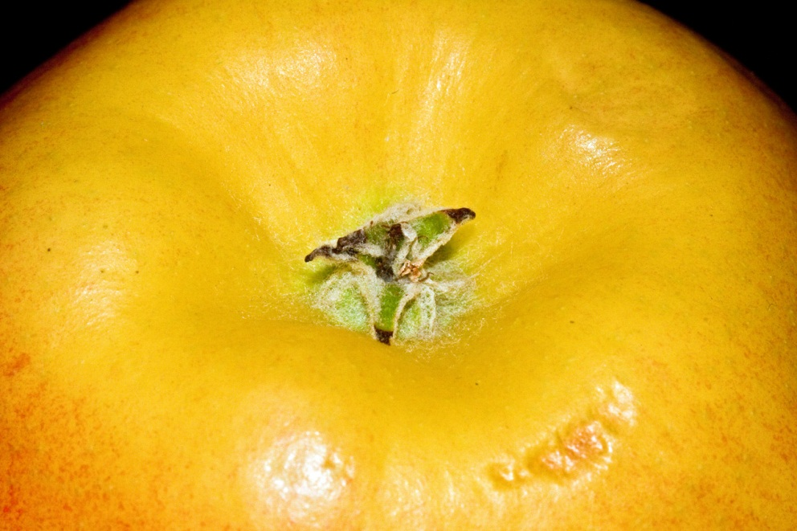
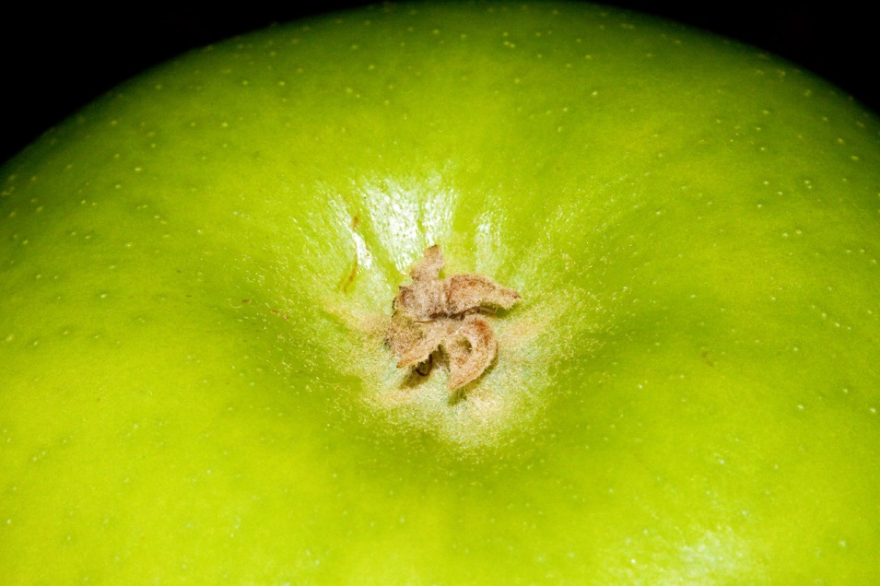
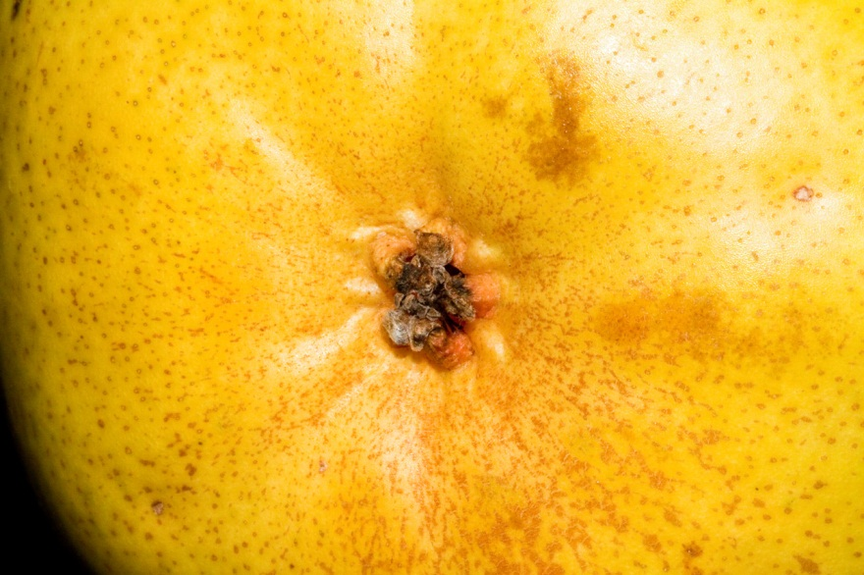
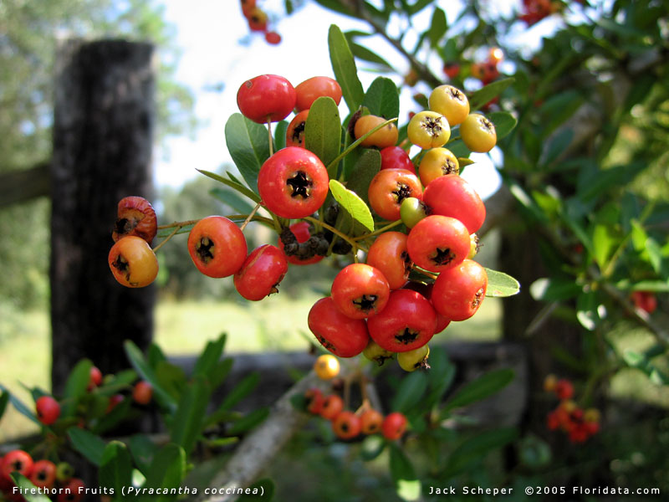
Fruits of Flowers of Rosaceae with Inferior Ovary (Epigynous insertion) and Hypanthium
Apple (Malus)
Apple (Malus)
Pyracantha
Pear (Pyrus)

Slide 38
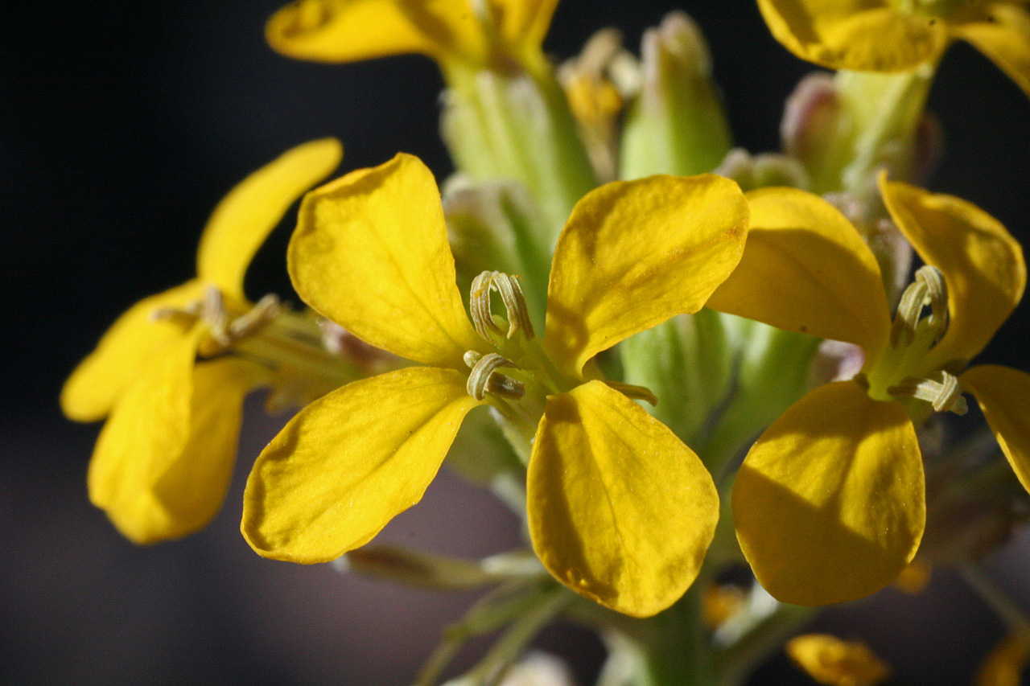
Merosity– i.e., 4-merous corolla of Erysimum capitatum

Slide 39
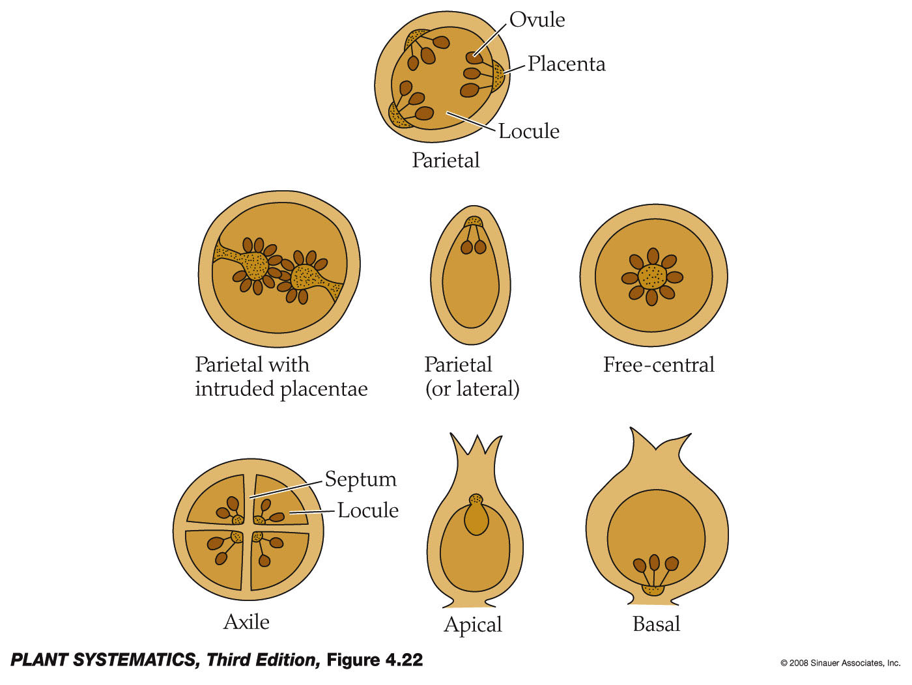
Placentation Types
Placenta= part of the ovary to which the ovules are attached.

Slide 40
Axile Placentation: Hibiscus (5 carpels)
Connate carpels= syncarpous

Slide 41
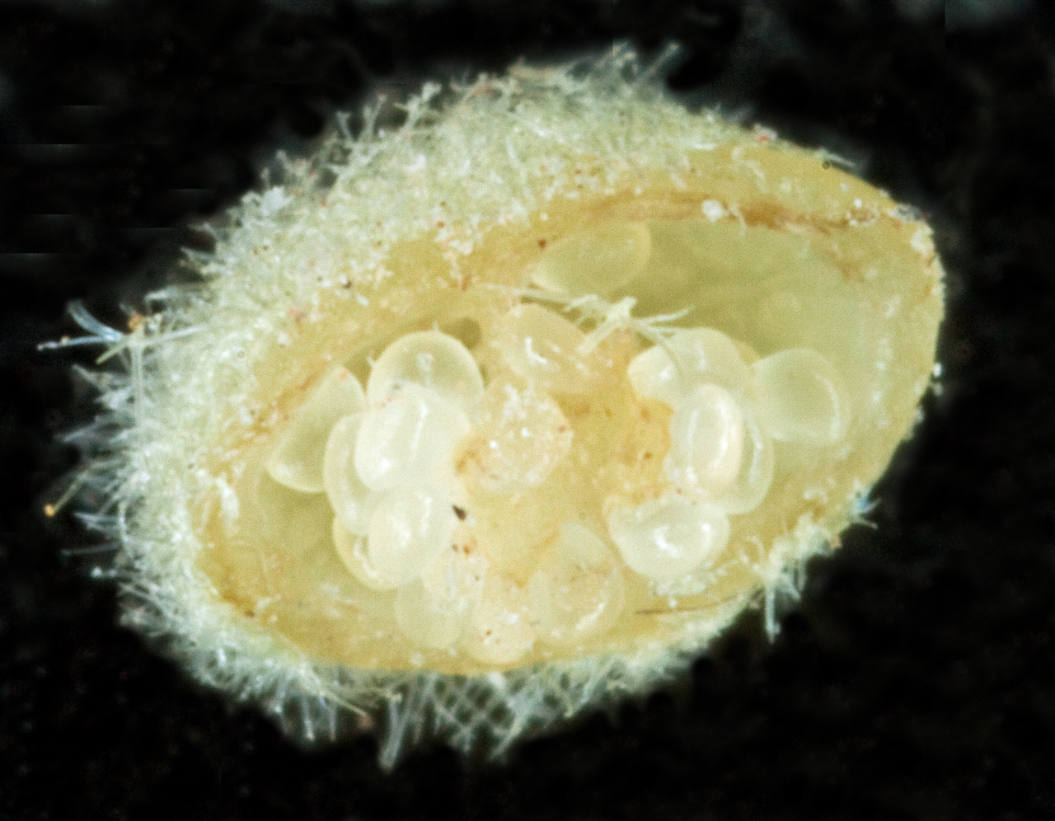
Axile Placentation: Solanum (2 carpels)
Connate carpels= syncarpous

Slide 42
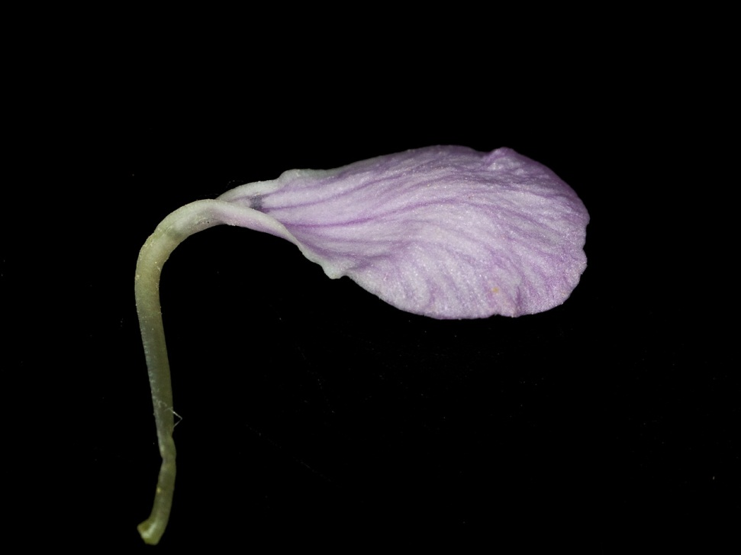
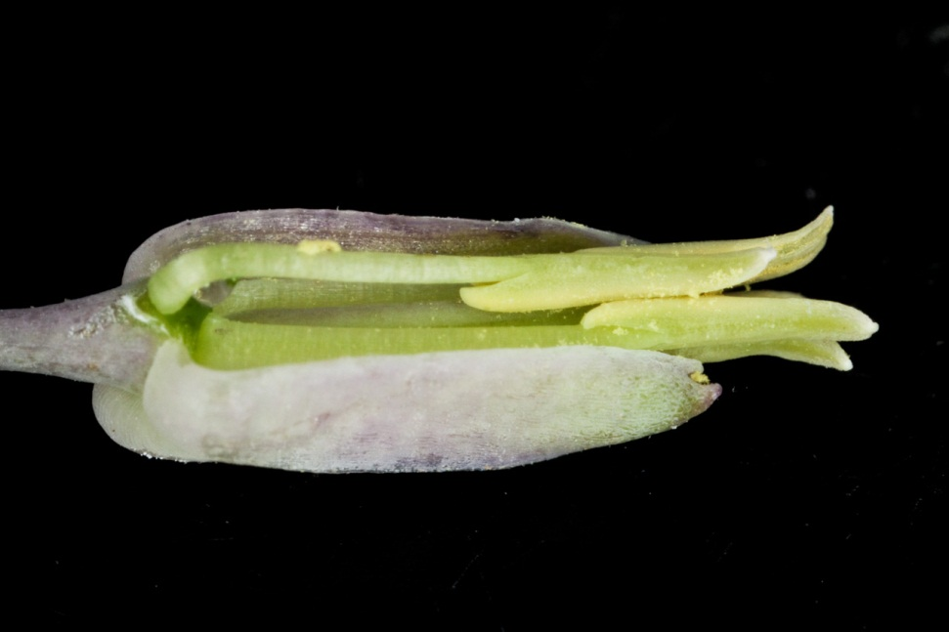
Brassicaceae: Hesperidanthus linearifolius
Clawed petal
Tetradynamous stamens

Slide 43
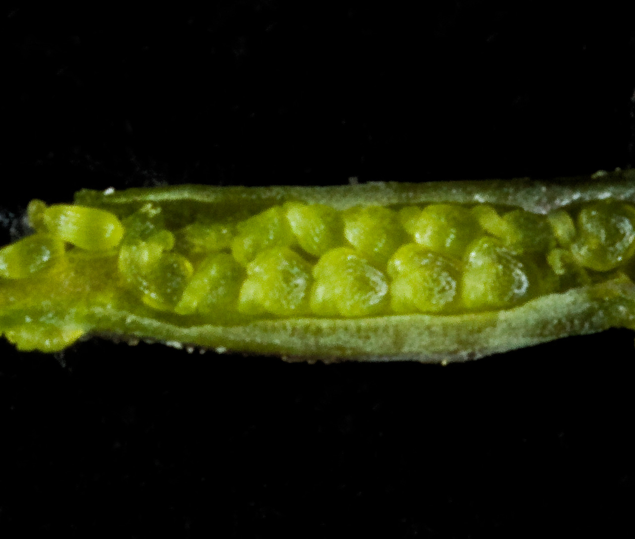
Brassicaceae: Hesperidanthus linearifolius– Parietal Placentation

Slide 44

Pollen Structure
Pollen structure: a basal layer (intine), overlayed by columns holding up an outer layer (exine) that may be highly decorated.

Slide 45


Slide 46

Angiosperm Life Cycle
Pollen is NOT the same as sperm!

Slide 47

A Mature Ovule

